Slide 1
Emmet.io HTML
Mr Benabderrezak
PHD-Student in cyber securitty
Future Pr

Slide 2
What Is emmet.io
Emmet (formerly known as Zen Coding) is a web development productivity tool
that allows developers to write HTML and CSS code using abbreviations or shortcuts that can be expanded into full HTML and CSS code

Slide 3
Using Emmet.io In HTML
include : >
Add : +
Multiply : *
On the line : ^
Number things: $
Group: ()
Fill in between tags : {}
ID, Classes and Table
custom attributes

Slide 4
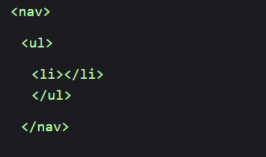
include : >
nav > ul >li

Slide 5
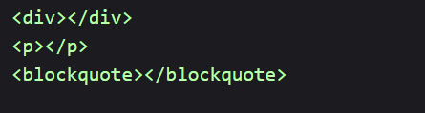
2. Add : +
div+p+bq

Slide 6
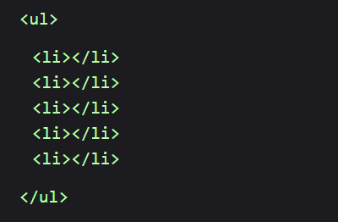
3. Multiply : *
ul>li*5

Slide 7
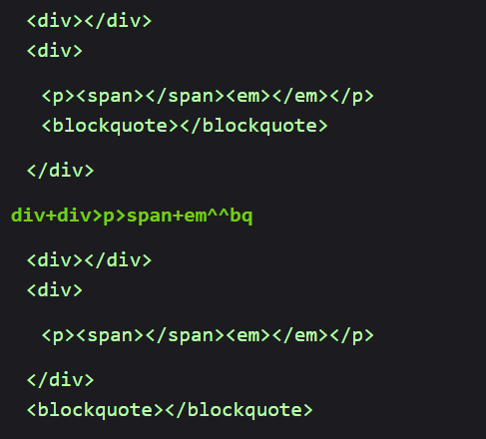
4. On the Line : ^
div+div>p>span+em^bq

Slide 8
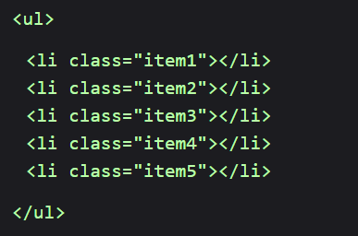
5. Number Things : $
ul>li.item$*5

Slide 9
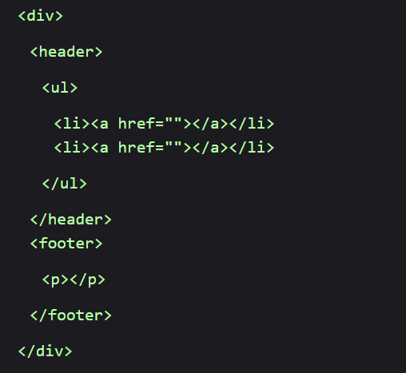
6. Group : ()
div>(header>ul>li*2>a)+footer>p

Slide 10

7. Fill in between tags : {}
a{Click me}

Slide 11
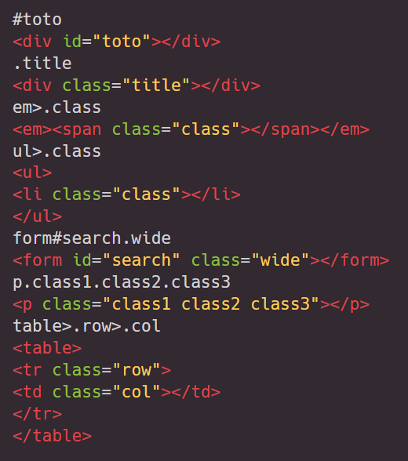
8. ID, Classes and Table

Slide 12
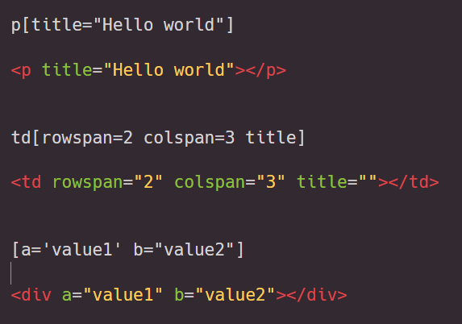
9. Custom attributes

